Slide 1
Obstacle Detection and Automated Engine
Cooling System Design for the Vehicle.
GROUP MEMBERS:
Lutfa Alam; (18-36945-1) SL-36
Shah Al Sadman; (17-34458-2) SL-11
Abdullah Al Noman; (18-36940-1) SL-35
M A Mohit Khan; (18-38002-2) SL-42
Dey, Showrav (17-35374-3) SL-15
Anik Dey Autu; (17-34560-2) SL-12
Islam, MD. Ashraful; (18-38031-2) SL-43
MD Sazzad Hossain; (18-38401-2) SL-44
Asif Hossain; (18-36983-1) SL-37
INSTITUTION: AMERICAN INTERNATIONAL UNIVERSITY BANGLADESH (AIUB)
COURSE: MICROPROCESSOR AND EMBEDEED SYSTEMS
SECTION: H
COURSE INSTRUCTOR: NADIA NOUSIN
GROUP No: 04

Slide 2
CONTENT
INTRODUCTION
LITERATURE REVIEW
COMPONENTS & CIRCUIT DIAGRAM
SIMULATION USING PROTEUS-8.0 SOFTWARE
FLOWCHART EXPLANATION
RESULT ANALYSIS
FUTURE ASPECT
DISCUSSION
REFERENCE

Slide 3
INTRODUCTION
Causes of road accident
Over speeding
Unable to detect obstacle
Avoiding safety rules
Red light jumping
Distraction to driver
Drunken driving
Facts of road accident
Approximately 1.35 million people die in road crashes,
3,700 people(on average) every day

Slide 4
INTRODUCTION (cont.)
Obstacle detection
Perform as to avoid collision with any other vehicle
Prevent road accidents
Achieve safe driving
Also known as self-anti-collision
Automated Engine cooling system
Avoid overheating of an engine
Avoid engine failure

Slide 5
LITERATURE REVIEW
The autonomous vehicles (AVs) have to ensure a continuous observation of the driving environment and all surrounding .Obstacle with its diﬀerent properties—size, shape, weight, material, frequency of appearance—is the most signiﬁcant element to focus on. Recently, some vehicle manufacturers already have made some progress on this front and there are many projects regarding this topics . For example,

Slide 6
LITERATURE REVIEW (cont.)
Using of AI and collected the data using Ultrasonic sensor [1].
An ARDUINO based system which has used two different (Infrared and ultrasonic) sensors [2] .
Using of Markov Random Field (MRF) model [3].

Slide 7
COMPONENTS & CIRCUIT DIAGRAM
1.Ultra Sonic Ranger Module
2. OLED Display
3.Termistor Based temperature Sensor
4.Yellow LED
5.Green LED
6. Red LED
7.Registor (1K , 10 watt)
8.Transistor(TIP120, A N-P-N transistor )
9.Diode (Model : 1N4001 , Silicon Rectifier )
10.A Battery (Dc voltage)
11.A motor (Simple dc )
12. Ground
13..Input (default)

Slide 8
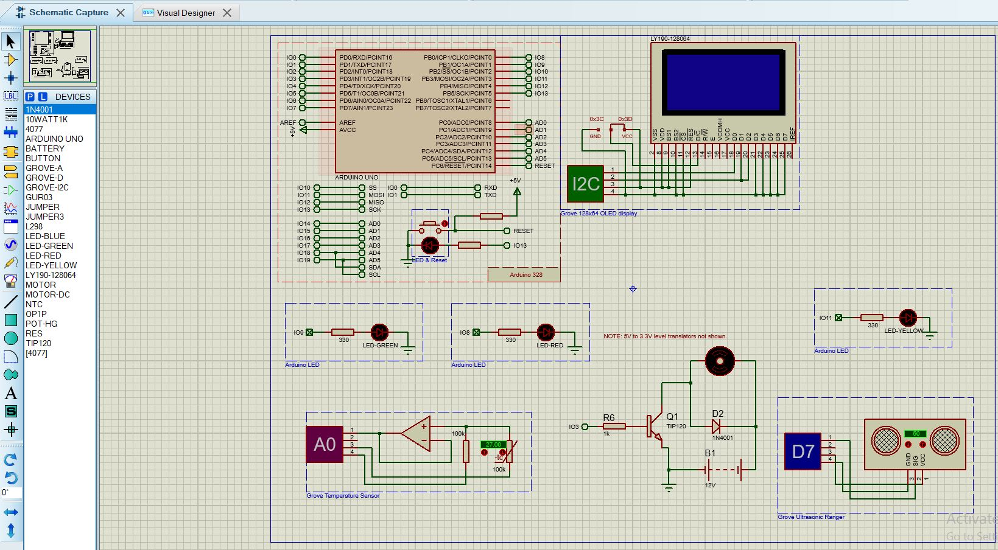
COMPONENTS & CIRCUIT DIAGRAM (cont.)

Slide 9
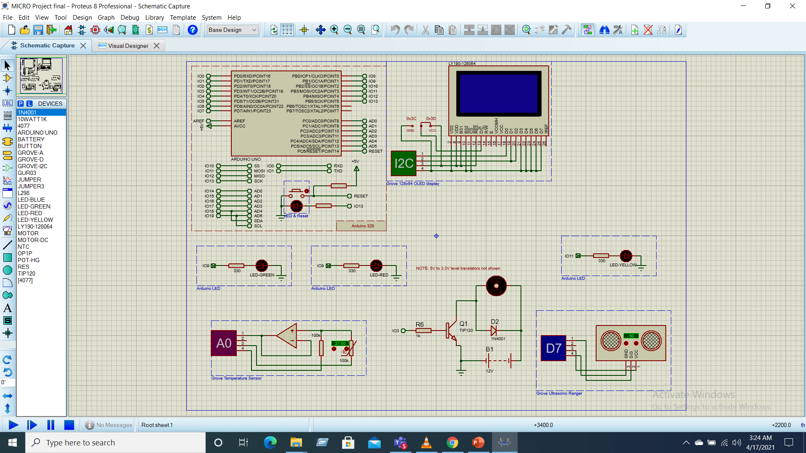
Fig: SIMULATION USING PROTEUS-8.0 SOFTWARE
Project Setup(Schematic Diagram)

Slide 10
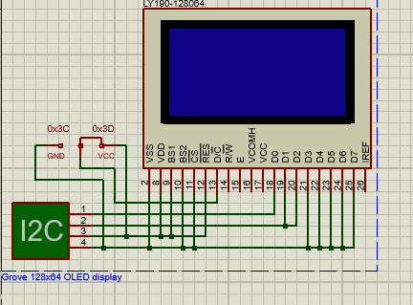
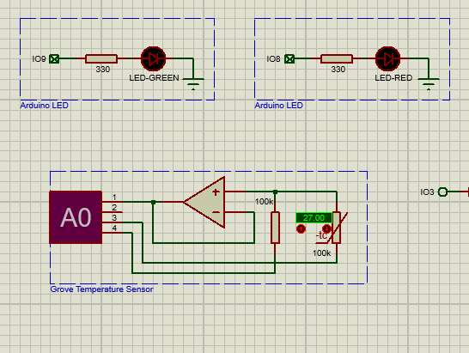
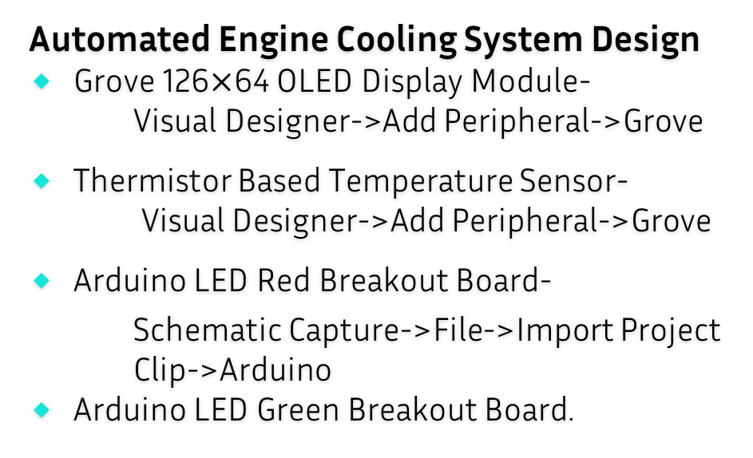

Project Setup(Schematic Diagram)
Automated Engine Cooling System Design
Grove 126$×$64 OLED Display Module-
Visual Designer->Add Peripheral->Grove
Thermistor Based Temperature Sensor-
Visual Designer->Add Peripheral->Grove
Arduino LED Red Breakout Board-
Schematic Capture->File->Import Project Clip->Arduino
Arduino LED Green Breakout Board.
Fig :Grove 126$×$64 OLED Display Module
Fig :Thermistor Based Temperature Sensor , Red & Green Led Breakout Board.

Slide 11
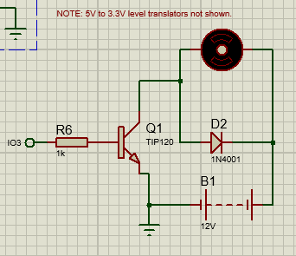
Project Setup(Schematic Diagram)
Cooling Fan design
1k, 10W Resistor.
TIP120 (Transistor n-p-n).
Simple DC Motor Model.
1N4001 Diode (Silicon Rectifier).
DC Voltage Source.
Schematic Capture->P
Ground.
Terminal Node->Ground
Default Input.
Fig : Cooling Fan Design

Slide 12
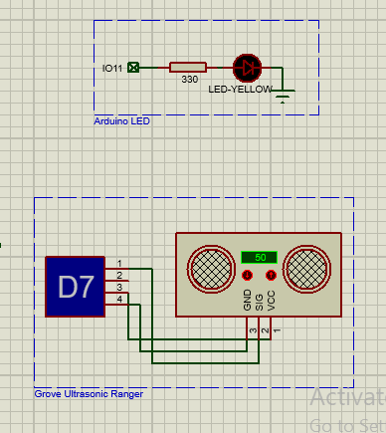
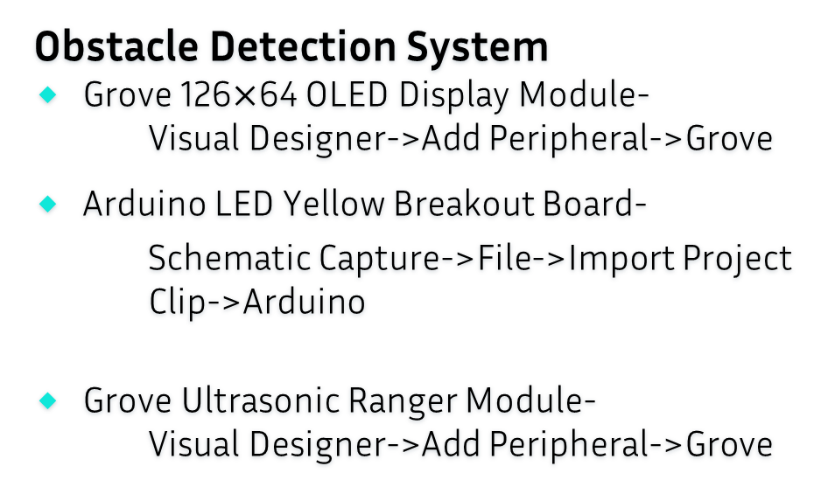

Project Setup(Schematic Diagram)
Obstacle Detection System
Grove 126$×$64 OLED Display Module-
Visual Designer->Add Peripheral->Grove
Arduino LED Yellow Breakout Board-
Schematic Capture->File->Import Project Clip->Arduino
Grove Ultrasonic Ranger Module-
Visual Designer->Add Peripheral->Grove
Fig :Grove 126$×$64 OLED Display Module
Fig :Grove Ultrasonic Ranger Module &
Arduino LED Yellow Breakout Board

Slide 13
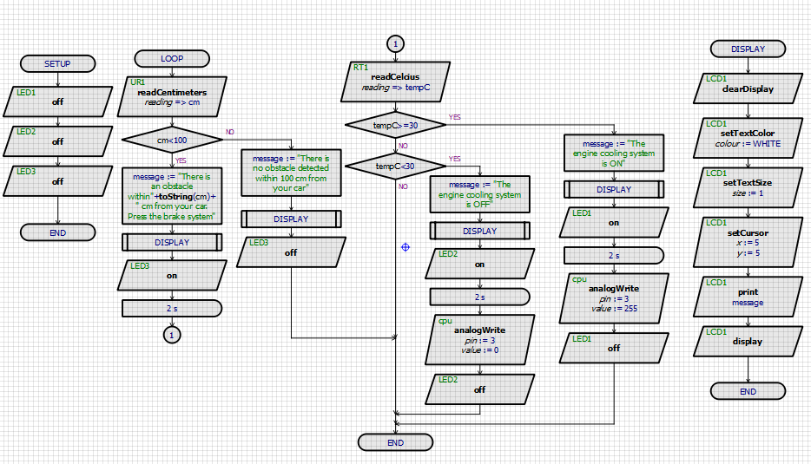
FLOWCHART EXPLANATION
Fig: Flowchart of Obstacle Detection and Automated Engine Cooling System Design for the Vehicle.

Slide 14
RESULT ANALYSIS
We have added the obstacle detected system in such way so that the system can identify an object which is less then 100 cm.
It will also determine the distance. We have given an example of 50 cm

Slide 15
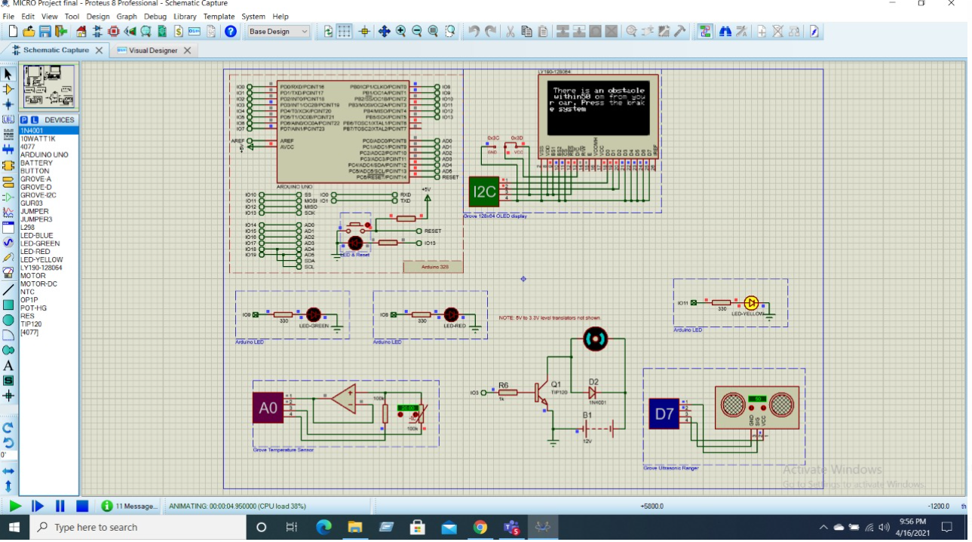
Fig: The Obstacle is at less than 100cm

Slide 16
Result Analysis (cont.)
If the obstacle is at 100 cm then the system will also show a message that there is no obstacle in 100 cm.

Slide 17
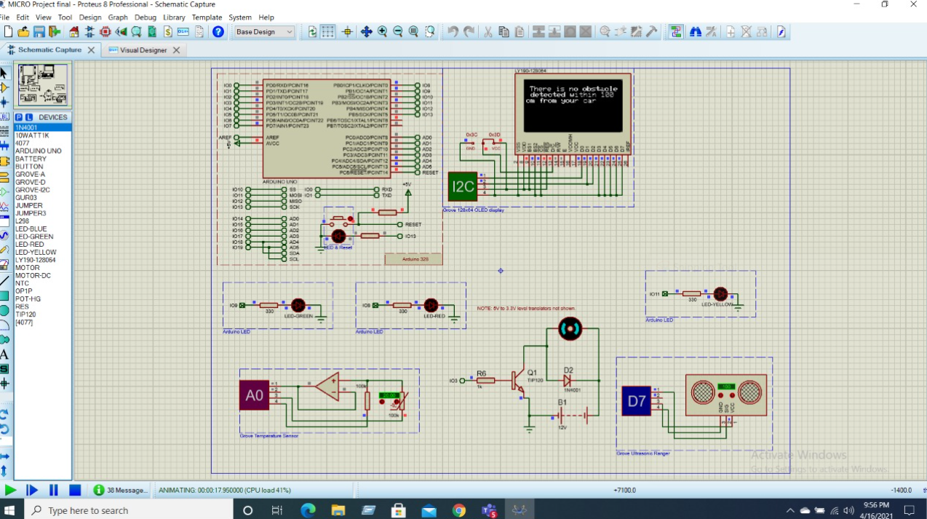
Fig: The Obstacle is at 100cm

Slide 18
Result Analysis (cont.)
Our system has a cooling method also.
If the temperature is in 25 degree Celsius then the cooling system will be off.

Slide 19
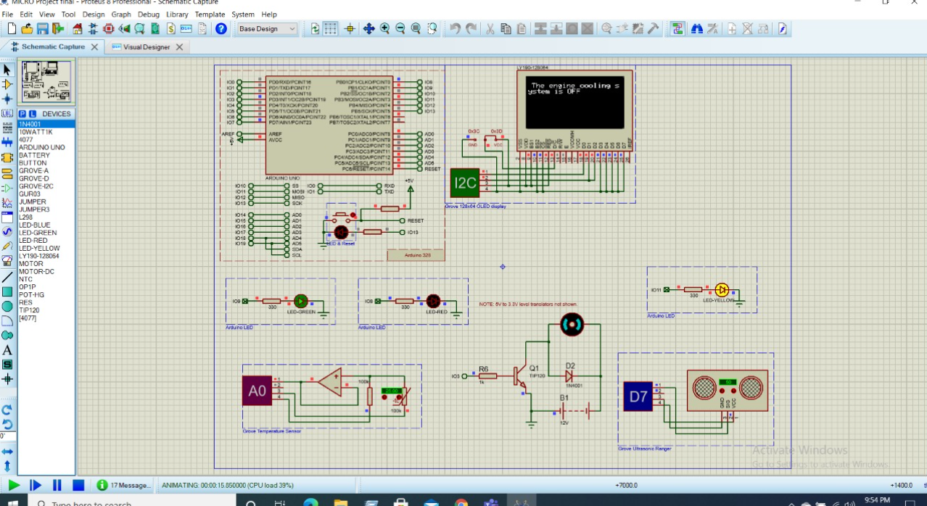
Fig: The Temperature is less than 30 degree

Slide 20
Result Analysis (cont.)
But if it crosses 30 degree Celsius then the system will understand it is an over heating problem.
The system will then show the message and automatically cooling machine will be turned on

Slide 21
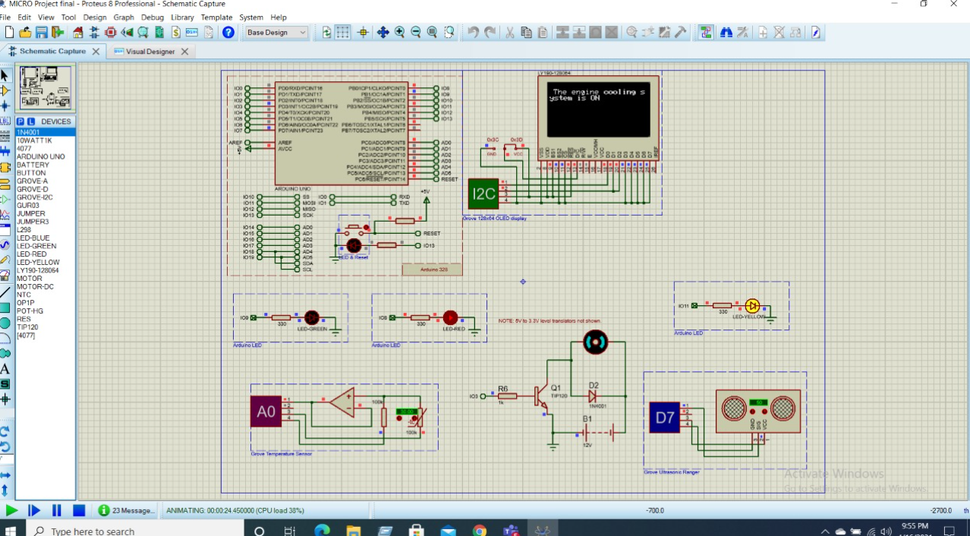
Fig: The temperature is above 30 degree

Slide 22
Limitation
The System is using for cooling engine besides its successful run it has some limitation like every project. We have seen this system took some time for giving output and display also took sometimes to show final message. And as Porteus is free Sofware so we can't run it as it shut down so many times.

Slide 23
FUTURE ASPECT
This is a basic feature of a vehicle we have by so far. But this feature have saved countless lives. Now extra features will require more cost but it is worthy of our lifes.We expect to see more safety features like
Airbags
Anti-Lock Brakes
Vehicle overspeed warning devices
Lane keeping assist
Car parking assist

Slide 24
Environmental impact
Many lives can be saved by adding advanced features to a car
Most of the cars are run by fossil fuels which causes air pollution, noise pollution
By adding advanced car the ability of traveling has been increased
Adding new job in society

Slide 25
DISCUSSION
In this project we develop a simple obstacle detector and automatic engine cooling system for vehicles using ARDUINO. To save human life and avoid unwanted accidents is the main focus of this project. For obstacle detection we use ARDUINO based hardware Grove Ultrasonic Ranger to detect obstacles along the path of the vehicle and for display, grove 128x64 OLED display. If the sensor detect any obstacle within 100 cm it will notify the driver about the break system of the vehicle. For cooling system, we use Grove temperature sensor. If the temperature of the vehicle’s engine goes up than 30 degree then it will turn on the fan and remained turn on until the temperature reduced to below 30 degree. This system is highly useful to avoid accidents and engine failure.

Slide 26
REFERENCE
[1]. Marco Claudio de Simone, Machines ,Obstacle Avoidance System for Unmanned Ground Vehicles by Ultrasonic Sensors , published:24th April 2018.
[2]. Kolapo Sulaimon Alli , Moses Oluwafemi Onibonoje ,Akinola S. Oluwole , ARPN Journal of Engineering and Applied Sciences , Development Of An ARDUINO Based Obstacle Avoidance Robotic System For An Unmanned Vehicles , published : 3rd February 2018 .
[3]. Malik Haris , Jin Hou , Sensors , Obstacle Detection and Safety Navigate The Autonomous Vehicle from Unexpected Obstacles on the Driving Lane , published :21st August 2020

